Slide 1
Enhancing Transparency, Participation, and Accountability through Social Media
Twitter/X Use by Government During the COVID-19 Pandemic
Notes:
Good afternoon everyone. Today, I will be discussing how government agencies used Twitter – now known as X – to directly engage with citizens and disseminate data during the COVID-19 pandemic.
We’ll look at the benefits, some key challenges, and what this means for open government going forward.
For clarity, I will be referring to the platform as Twitter for the duration of this presentation as that is what the platform was called during the time it was being used in this context.
Frame within open government goals: transparency, participation, accountability, and inclusion

Slide 2
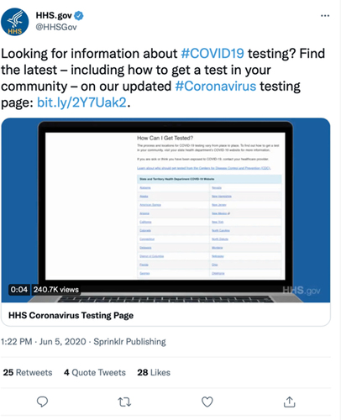
Real-Time Information and Public Communication
  State and local governments used Twitter to share real-time updates
    Case counts
    Emergency regulations
    Testing and vaccination information
  Agencies such as the Center for Disease Control (CDC) and World Health Organization (WHO) used Twitter to communicate evolving health guidance
    Data Dashboards
Notes:
Twitter was used as a platform for immediate, wild-scale dissemination of data during a time when in-person contact was limited.
During COVID-19, governments sere able to share real-time updates on case numbers, mask and quarantine guidelines, and testing and vaccination information.
Agencies like the CDC and WHO were able to use Twitter to announce new guidelines and dispel misinformation. This included the linking of data dashboards to tweets to promote transparency.
The real-time nature of the platform helped reach millions of people with timely information in a time of high uncertainty.

Slide 3
Interactive Public Participation and Feedback
Citizens engaged directly with officials and agencies through replies, threads, and Q&A sessions
Officials used polls and hashtags to gauge public opinion and dispel misinformation
Twitter became a space for dialogue between the government and the public
Notes:
Twitter enabled a two-way exchange of information. Citizens could directly ask questions, raise concerns, and report local issues through replies, threads, and live Q&A sessions. Public feedback helped agencies gauge public opinion, adjust messaging, and improve outreach strategies in real-time.

Slide 4
Challenges of Using Twitter/X in Crisis Governance
Information overload and algorithm bias
Rapid spread of misinformation and disinformation
Exclusion of non-users or digitally connected communities
Lack of unified messaging across jurisdictions
Notes:
However, there were serious downsides. The large volume of content led to confusion and hindered clarity. Some groups, specifically those without digital access, were excluded from updates altogether.
Misinformation and disinformation spread rapidly as governments struggles to manage consistent and trusted information, undermining credibility and response effectiveness. Inconsistent messaging weakened the public’s trust in the government.

Slide 5
Moving Toward a More Open and Responsive Government
Social media if used equitably and transparently, can enhance democratic governance.
Social media strengthens open government principles of:
  Transparency
  Participation
  Accountability
  Inclusion
Notes:
While not perfect, platforms like Twitter help modernize how governments interact with the public. They allowed for more transparent, participatory, and inclusive communication during the COVID-19 pandemic. Social media strengthens open government principles of transparency through real-time communication which builds trust; Participation by enhancing citizen voice and allowing for two-way communication; Accountability because as we know “the internet is forever”. These posts and interactions are traceable public communication forums; and inclusion by providing broader reach in emergencies
Moving forward, social media platforms have been and will continue to be key tools for crisis response and democratic governance.

Slide 6

Questions?

